Slide 1

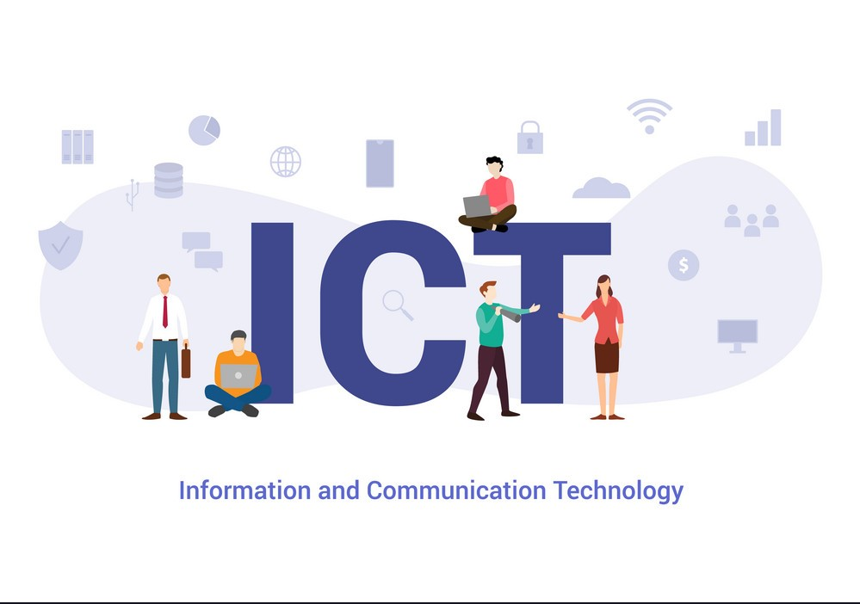
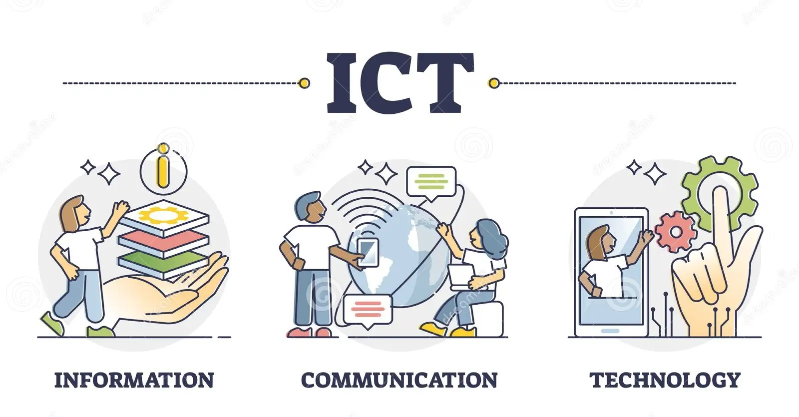
ICT and technologies related to ICT
intro

Slide 2

Contents
Definition
Technologies related to ICT
Overview of ICT technologies
Example of ICT Technologies (Google Services /Microsoft Tools/Git & Github/AI & ML)
Importance of ICT
Contents

Slide 3
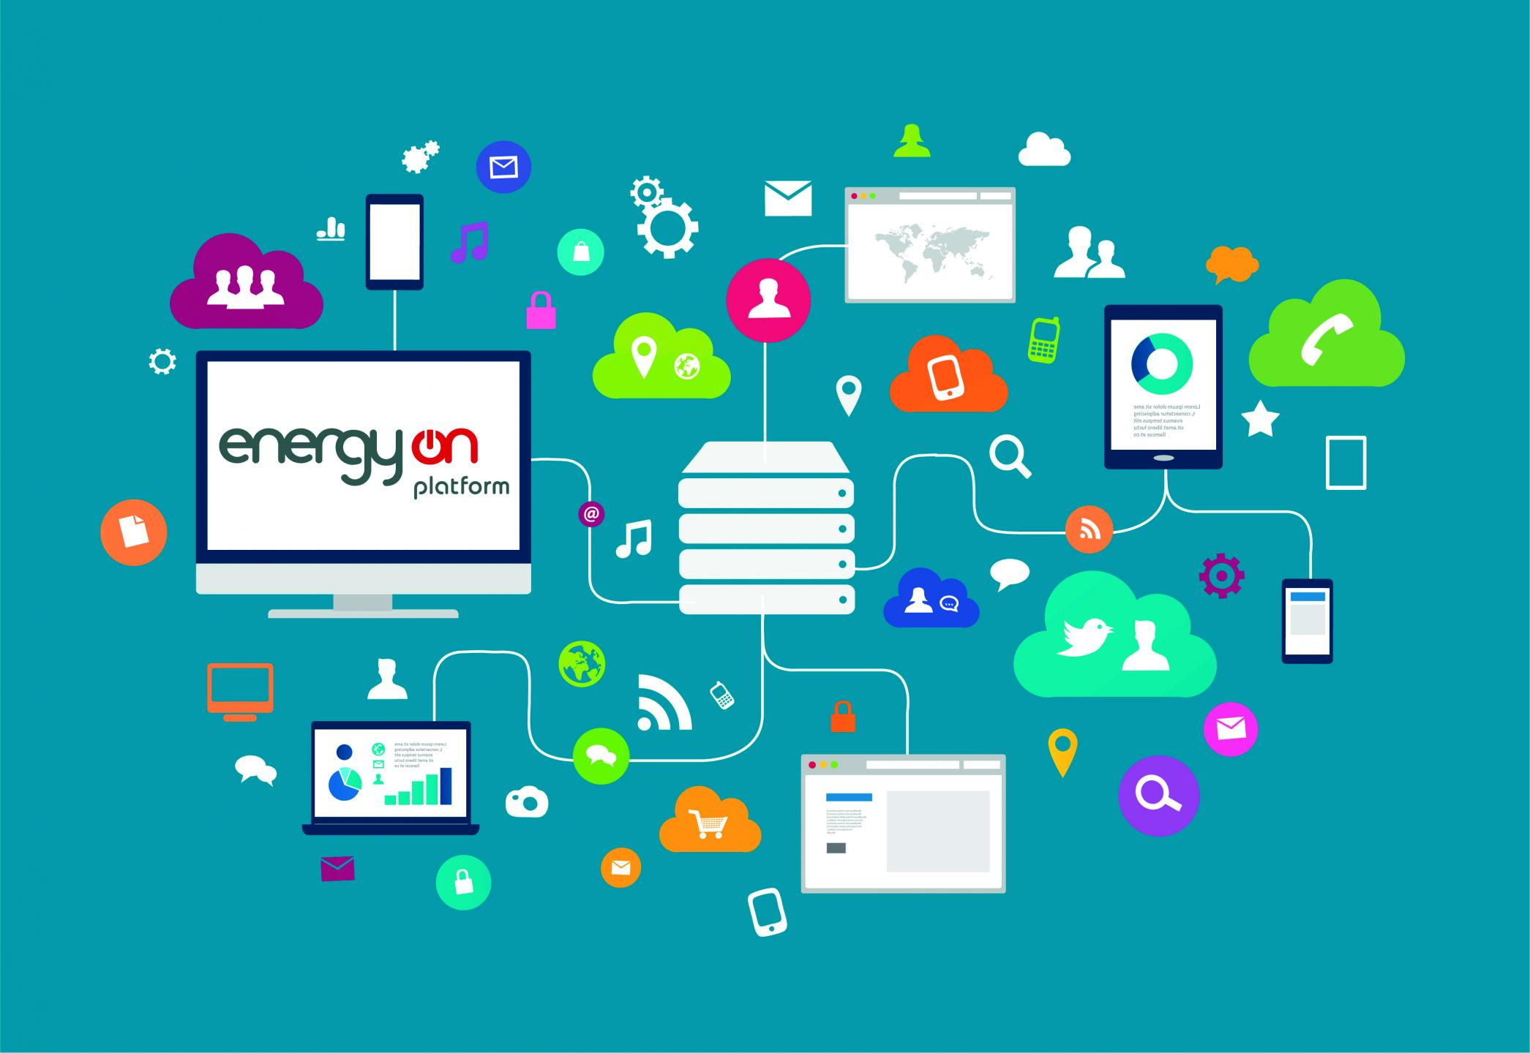
Definition
“ICT" typically refers to "Information and Communication Technologies," encompassing various tools, systems, and methods used for communication, data management, and information sharing in modern contexts.
The primary goals of (ICT) involve improving communication, enhancing data accessibility, and fostering innovation through efficient technology utilization across diverse fields and industries.
Page : 1

Slide 4
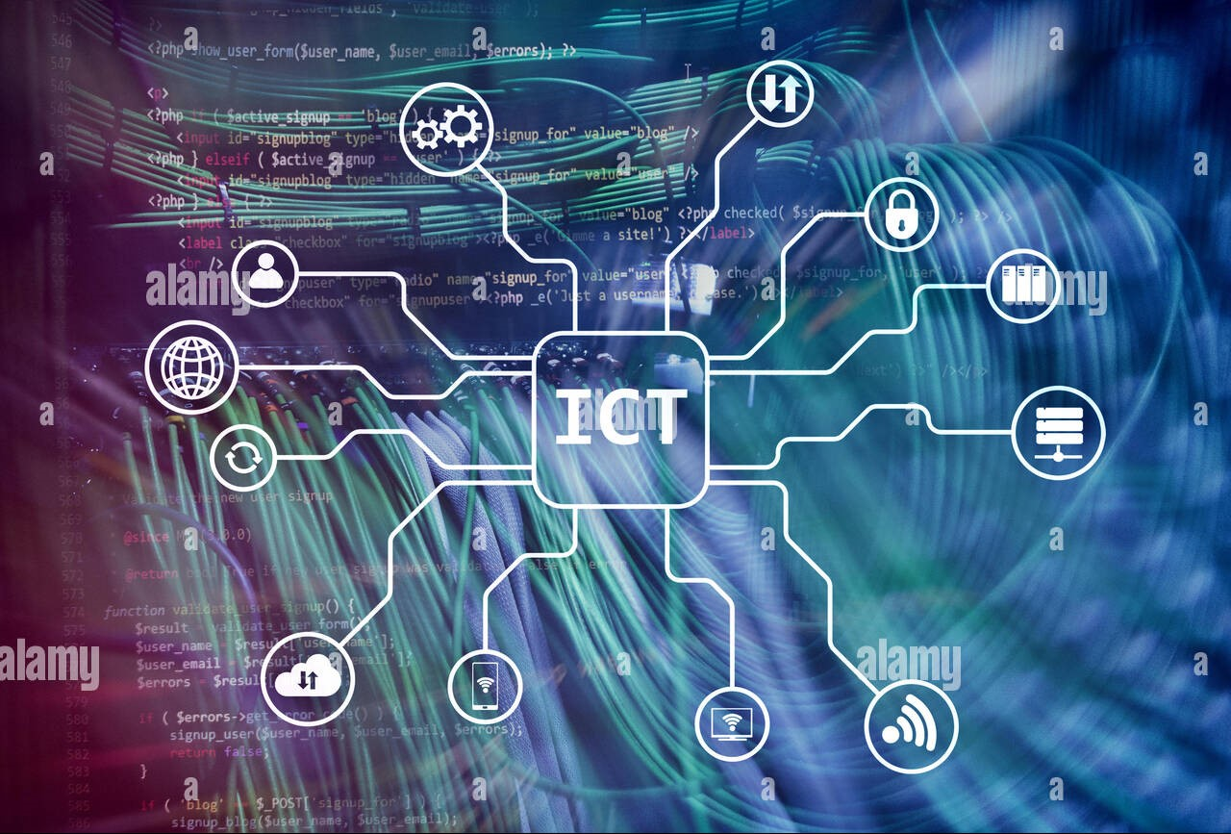

Technologies related to ICT
Here's an overview of some key ICT technologies:
Computing Technology : Computing technology encompasses hardware, software, and networks.
Networking Technologies : Networking tech creates global connections, allowing devices to communicate and share data efficiently across various platforms.
Data Storage and Management : Data storage and management ensure efficient organization, security, and accessibility of information across platforms amid growing data volumes.
Telecommunications Technology : Telecommunications technology enables global data transmission and communication through diverse mediums and protocols across networks.
Page : 2

Slide 5
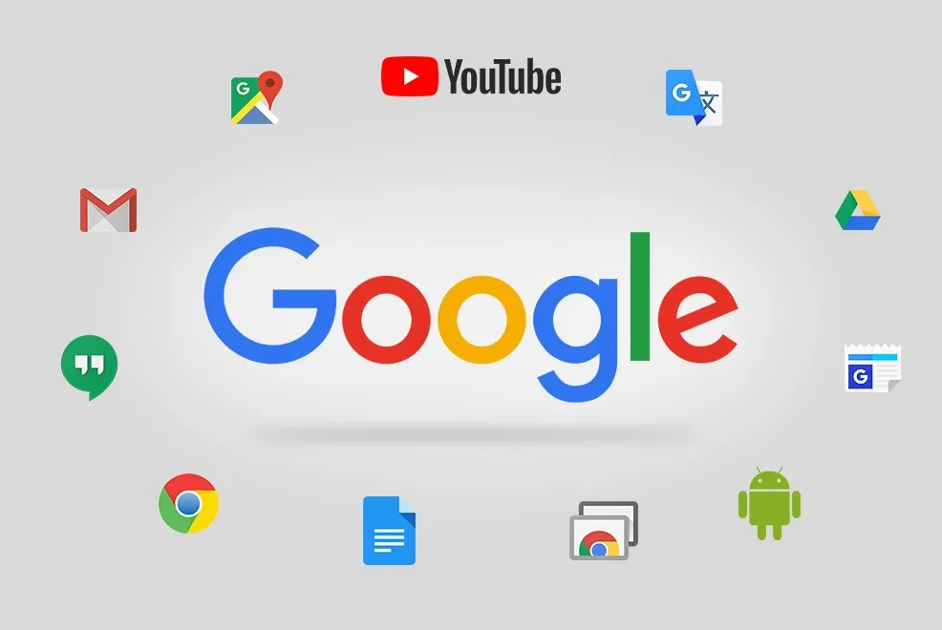
Example of ICT Technologies
Google services : encompass a comprehensive suite of digital tools, applications, and platforms provided by Google, catering to various needs and aspects of digital life. These services include:
Youtube
Google Drive
Google Chrome
Google Calendar
Page : 3
Gmail
Google Docs
Google Photos
Google Maps

Slide 6
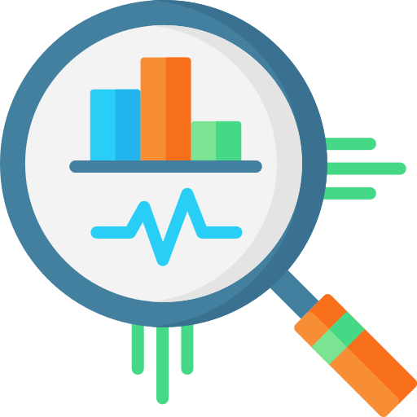


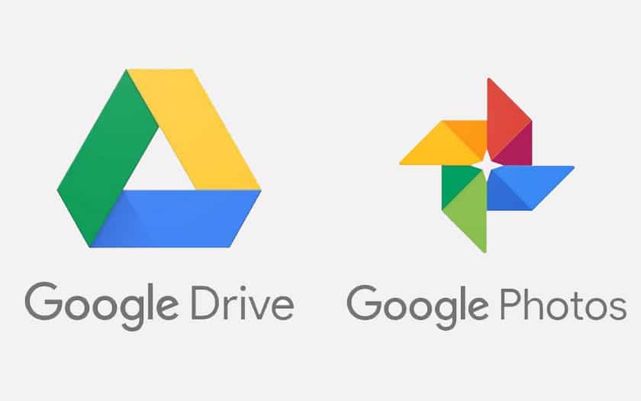
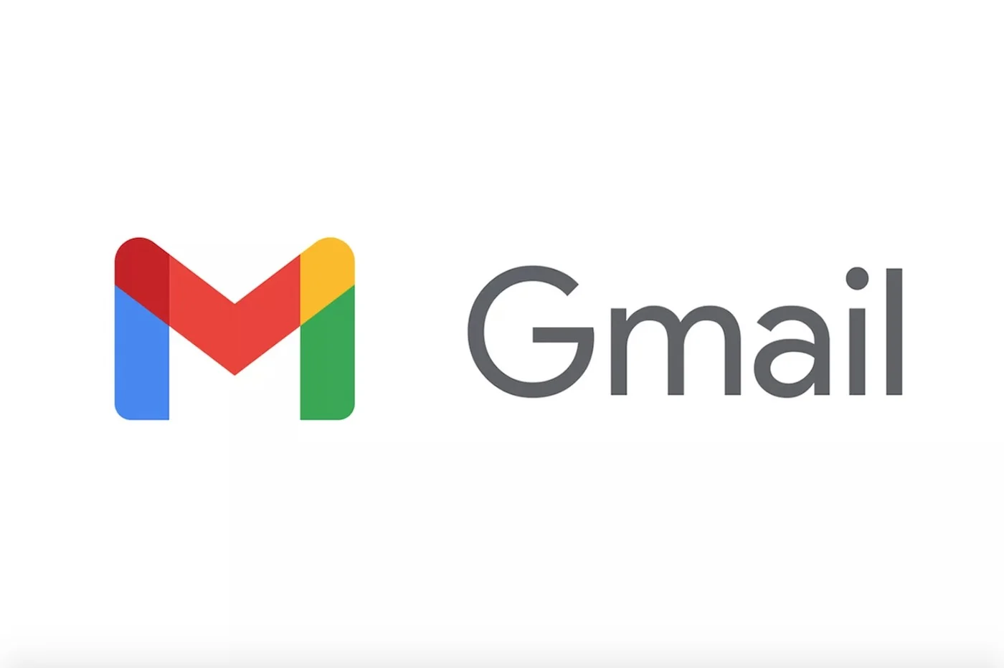
As of the last update in January 2022, Google's services were widely used globally. Here are some statistics regarding the user base for several key Google services:
2,5 billion monthly
2 billion monthly
1.5 billion
1 billion
Page : 4

Slide 7



Google services have a profound relationship with Information and Communication Technologies (ICT), Here's how Google's services intertwine with ICT:
Page : 5
Access to Information
Google Search revolutionized accessing vast data, showcasing ICT's power in managing and presenting information online.
Communication Tools
Gmail and Google Meet use technology to enable global communication, showcasing ICT's role in connecting people effortlessly.
Cloud Computing
Google Cloud Platform: ICT's scalable, cloud-based services empower businesses and developers with versatile computing resources.

Slide 8





Microsoft Tools :Microsoft tools encompass a wide array of software applications, platforms, and services developed by Microsoft Corporation, catering to various needs. Some key Microsoft tools include:
Page : 6
Office
Includes applications like Word, Excel, PowerPoint, Outlook
Azur
A cloud computing platform
Microsoft Dynamics 365
An integrated suite of business applications for customer
Power Bi
A business analytics tool used for data visualization, sharing insights
Microsoft Edge
A web browser developed by Microsoft, offering tools for browsing, searching

Slide 9


Git and GitHub : they are related but distinct tools used in software development for version control, collaboration, and code management.
Git | Github
It is a software | It is a service
It is installed locally in the system | it is hosted on web
It is a command line tool | It provides a graphical interface
It is a tool to manage different versions of edits , made to files in a git repository | It is a space to upload a copy of the git repository
It provides functionalities like version control system source code managment | It provides functionalities of git like VCS , system source code managment as well as adding few of its own features
Page : 7

Slide 10
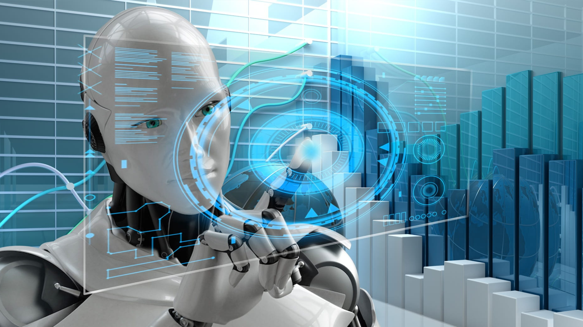
4) Artificial Intelligence(AI): is a broad field of computer science that aims to create machines or systems capable of performing tasks that typically require human intelligence.
Machine Learning: Machine learning is a branch of artificial intelligence where computers learn from data and improve their performance on tasks without explicit programming.
The relationship with ICT:
Page : 8
1
Data Analysis and Interpretation
3
3
2
Automation And Efficiency
3
Personalization
4
Predictive Analytics

Slide 11


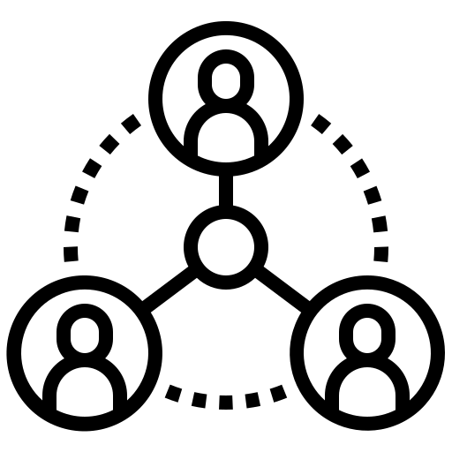

Importance of ICT
Page : 9
1
Connectivity
2
Economic Growth
3
Education and Learning
4
Healthcare Advancements

Slide 12
THANK YOU!
End of project
end
Groupe 41

